Slide 1


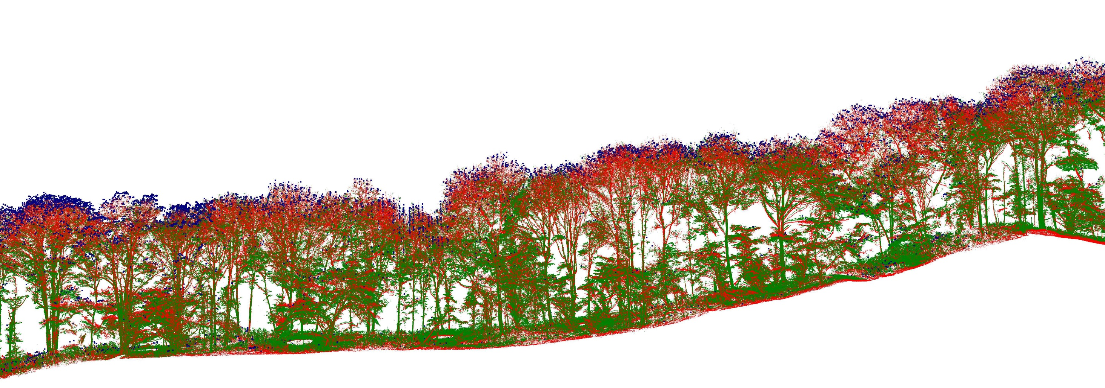
Estimating critical wind speed in a natural forest
Toby Jackson
tobydjackson@gmail.com

Slide 2
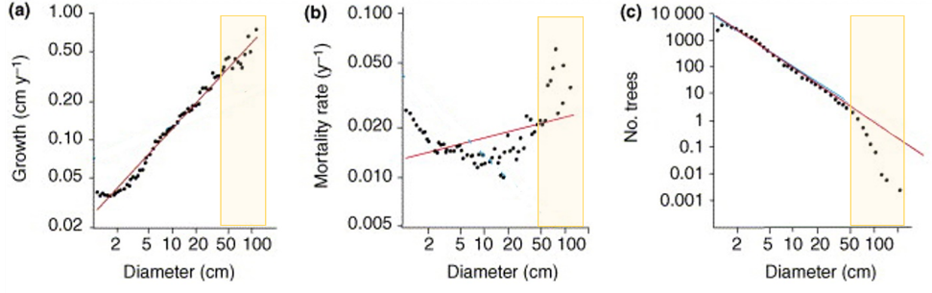
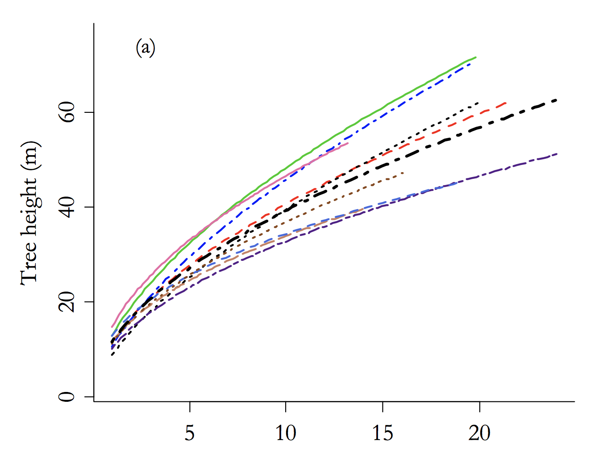
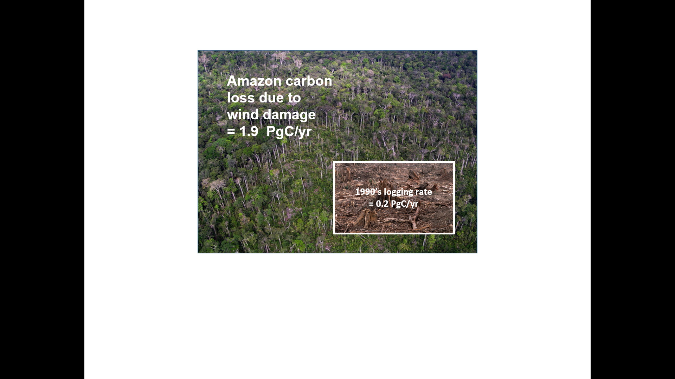
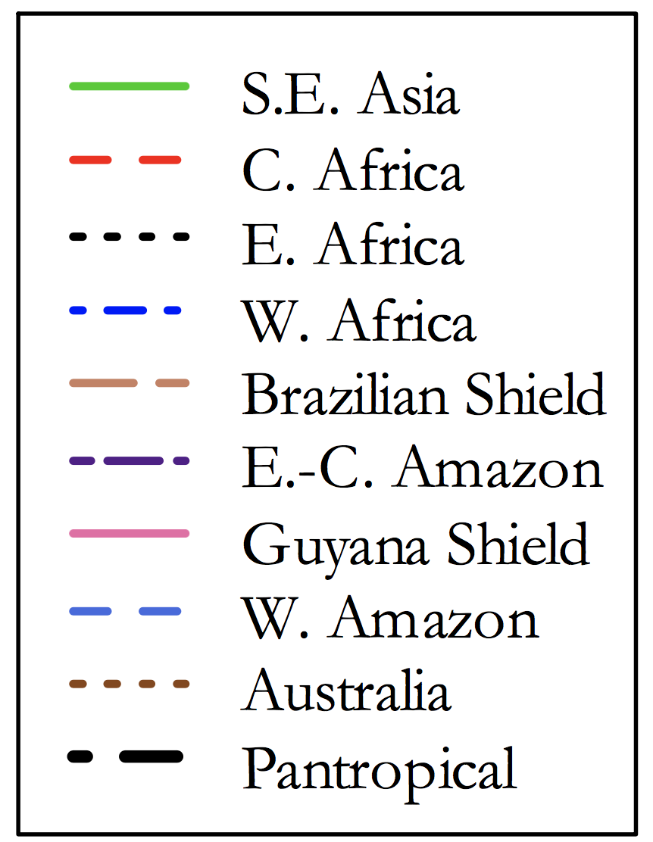
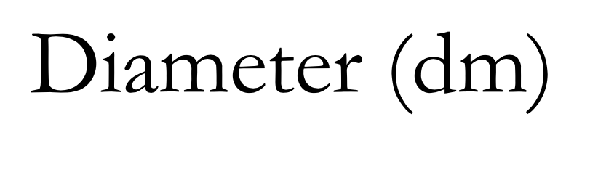
Motivation
Espirito-Santo et al. (2015)
Coomes et al
Feldspauch et al, Biogeosciences (2012)
Height-diameter allometry of tropical forest trees

Slide 3

This presentation
Wytham fieldwork - data available
Finite element modelling of trees based on terrestrial LiDAR data – codes available
Side projects
Resonant frequencies
Borneo tall trees

Slide 4
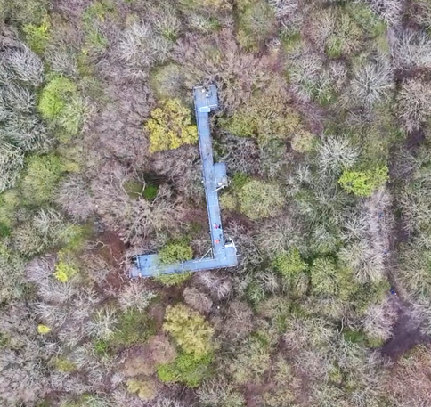
Wytham Fieldwork
(data available)
Strain data
8 months
21 trees
Summer / winter
Wind profile
Census data
2008, 2010, 2016
Species, DBH, height
Soils
MET data

Slide 5
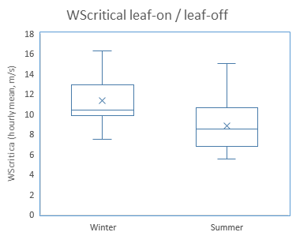
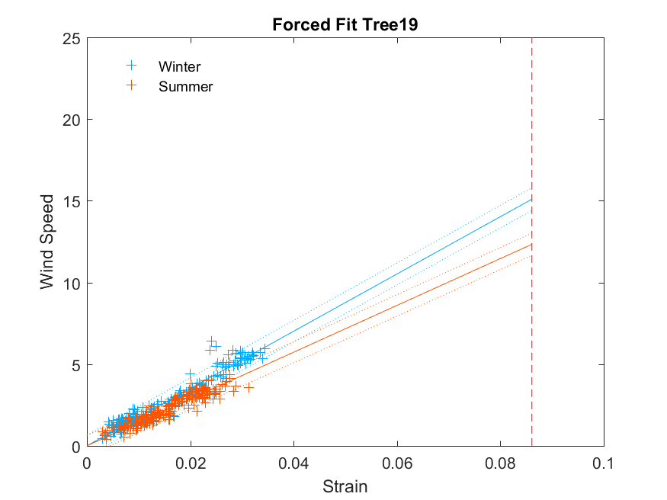
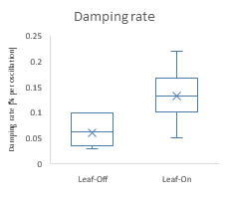
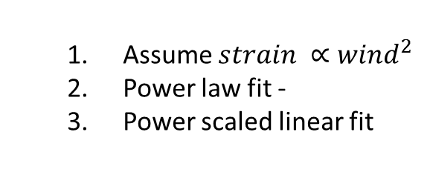
Field data - results
Assume $strain ∝wind^{2}$
Power law fit -
Power scaled linear fit
Notes:
Can I show that dynamic processes don’t matter?

Slide 6
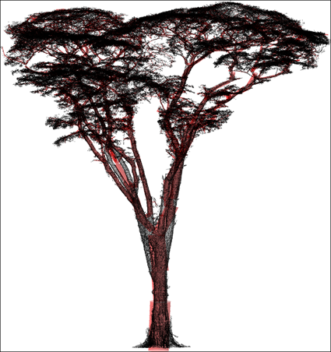
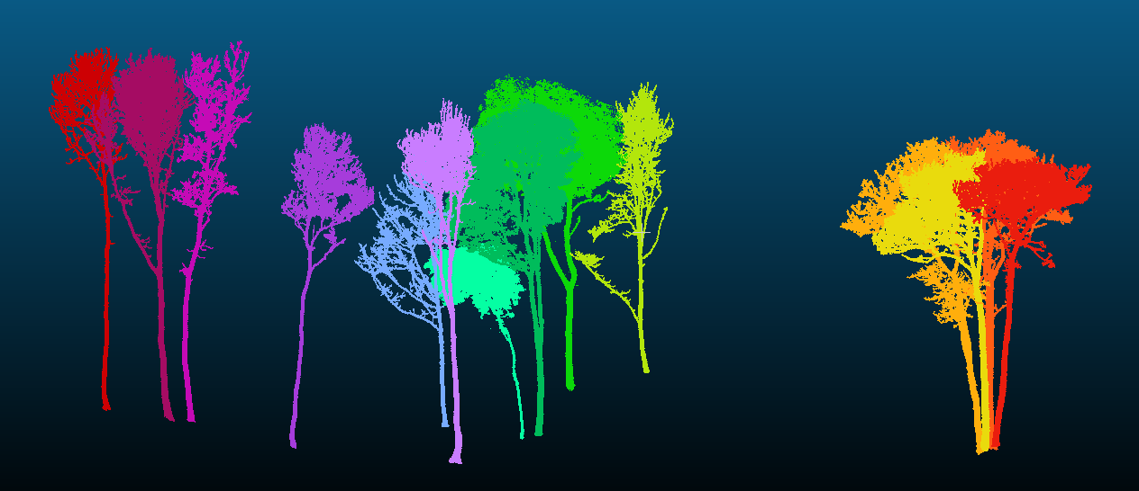
TLS data
Terrestrial LIDAR Scanning
Co-located with census data
6ha – 5000 trees in Wytham
Plots all over the world
Open grown trees
Codes available

Slide 7
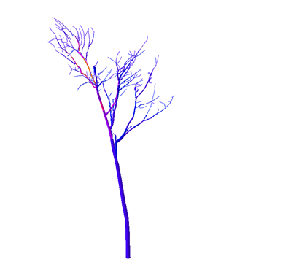
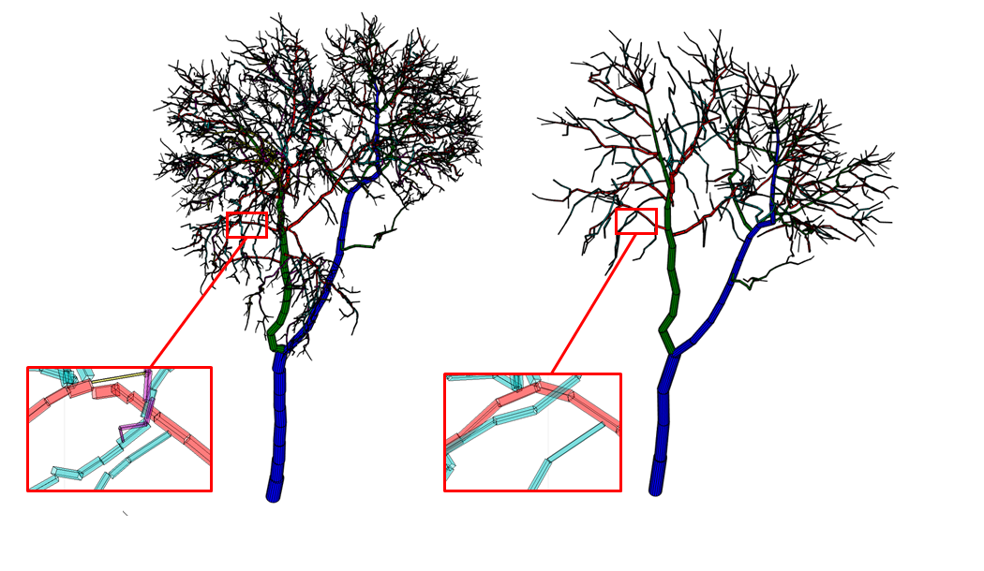
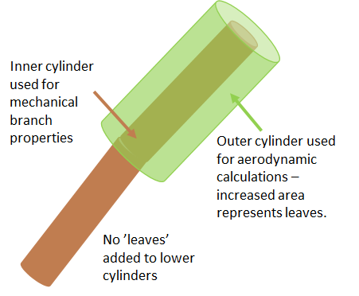
Process
1. Simplify
4. Model resonant frequency and dynamics
2. Materials (literature picture)
3. Leaves

Slide 8
5. Validate – winter and summer graphs here
6. Scale-up

Slide 9
Results – 1ha

Slide 10
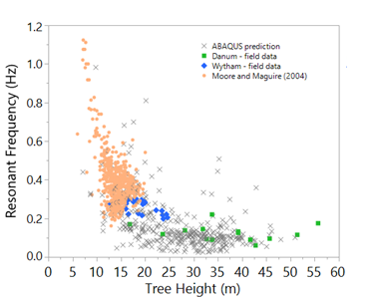
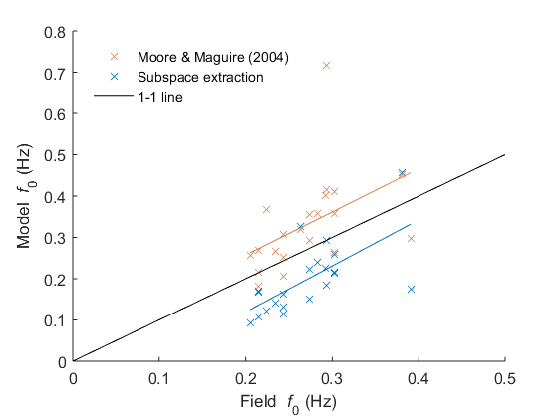
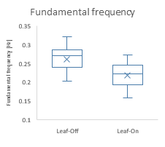
Resonance project
Maybe get that global resonant frequency picture in stages?
Most trees have multiple resonances
Pine trees and tall trees have one
Abaqus predicts resonant frequencies
Time-series of resonant frequencies
Leaves and water?
HIGHER ORDER DATA!

Slide 11
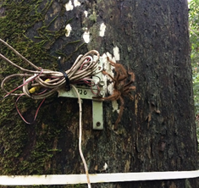
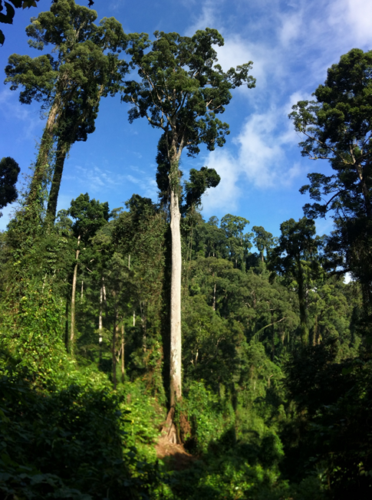
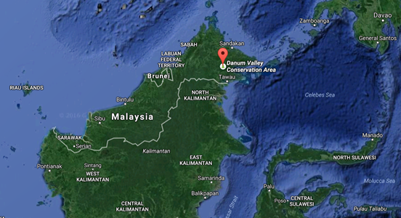
Borneo
Same as for Wytham but
Trees are bigger
Creepy crawlies

Slide 12
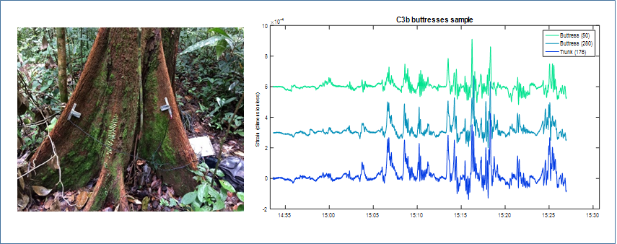

Slide 13
This presentation
Wytham fieldwork - data available
Finite element modelling of trees based on terrestrial LiDAR data – codes available
Side projects
Resonant frequencies
Borneo tall trees

Slide 14
Questions?
Toby Jackson
tobias.jackson@ouce.ox.ac.uk

Slide 15
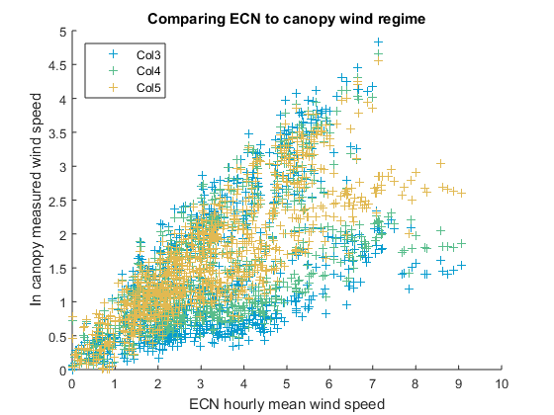

Slide 16
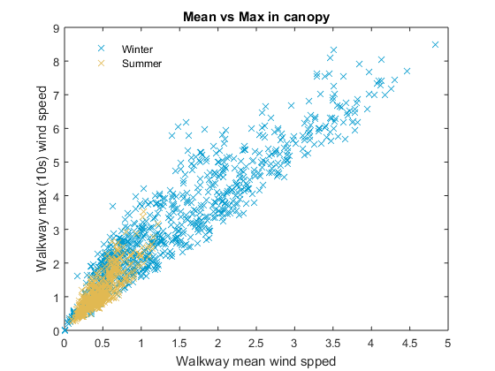
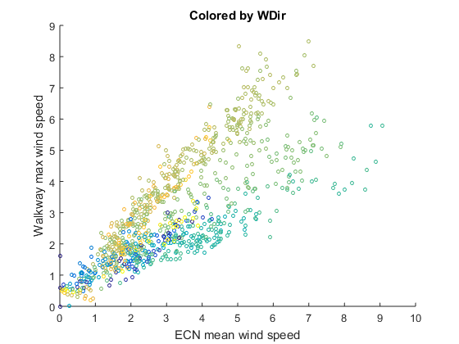

Slide 17
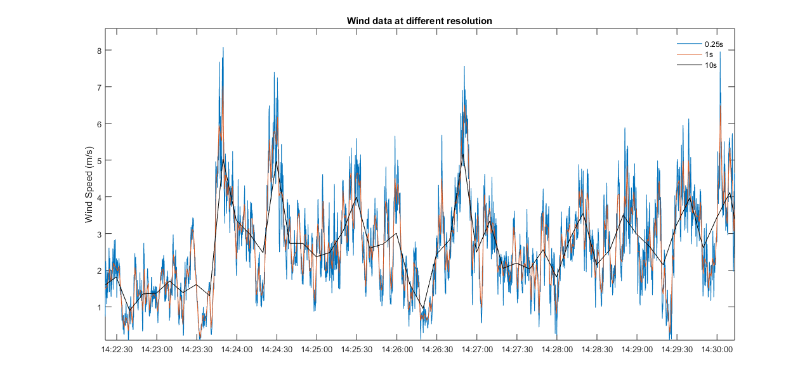

Slide 18
